Slide 1
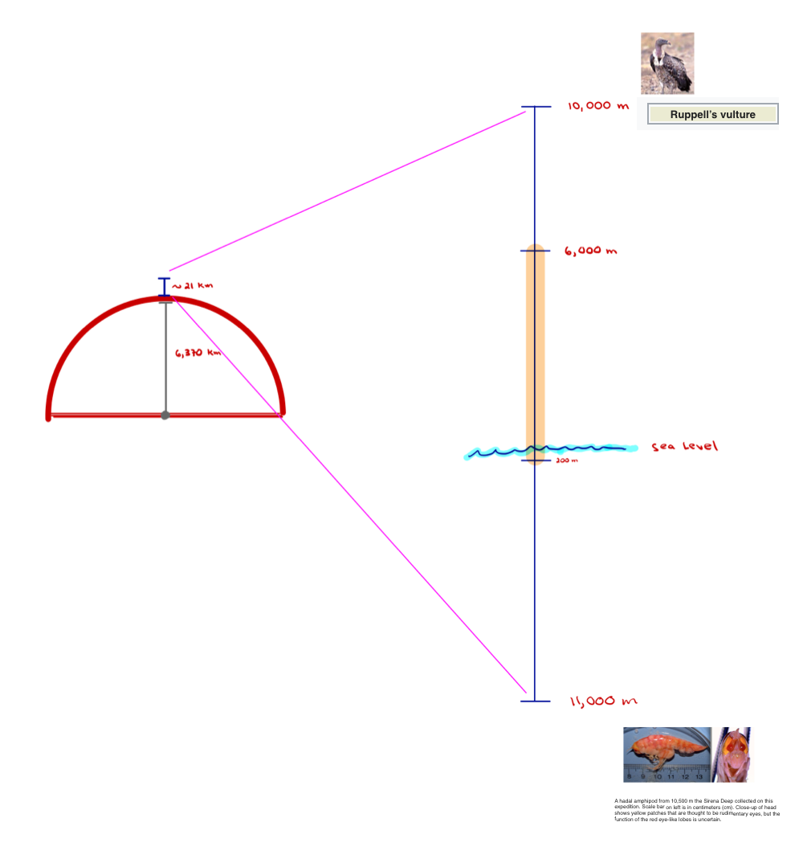
The Biosphere

Slide 2
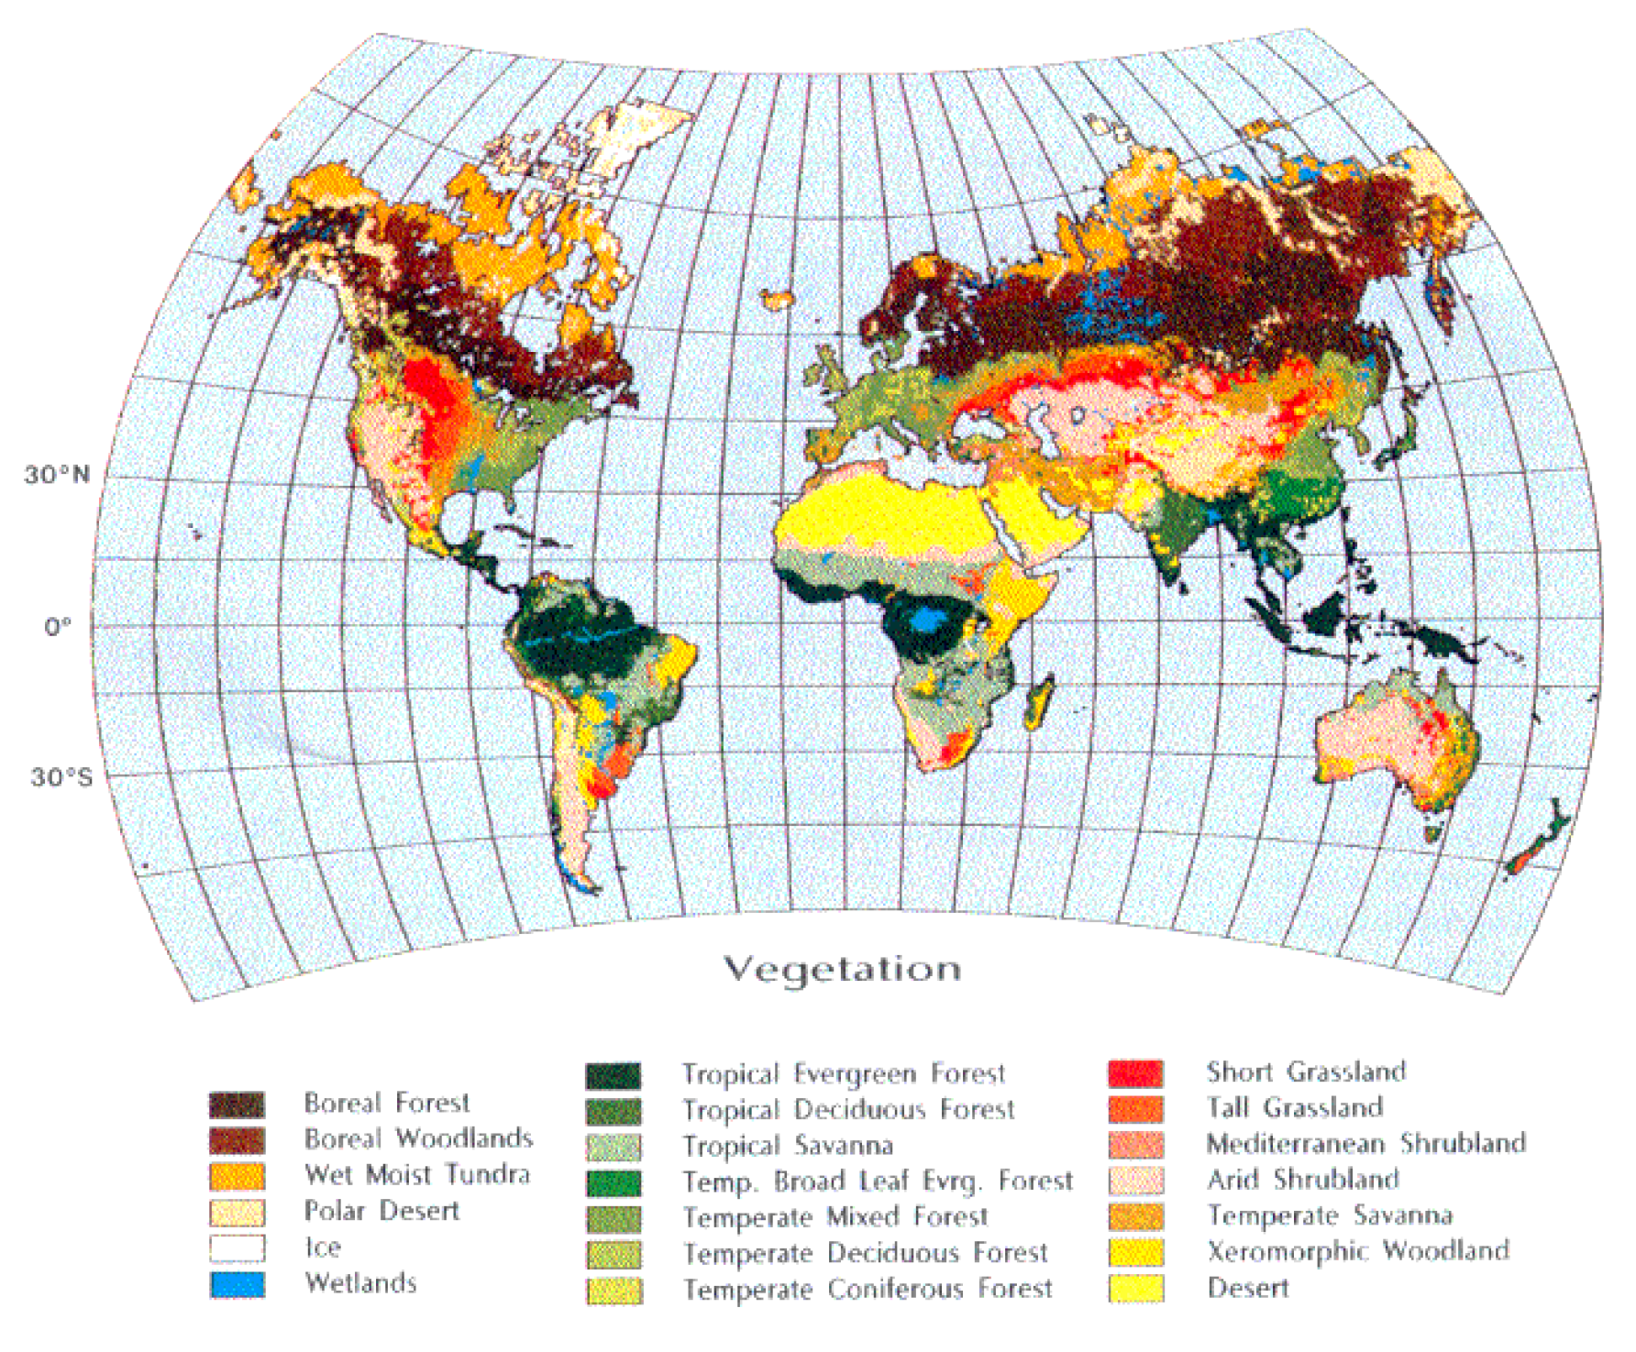

Slide 3
Notes:
http://virtual.yosemite.cc.ca.us/randerson/Lynn's%20Bioslides/slides.htm
http://www.nrc-cnrc.gc.ca/fra/education/index.html

Slide 4
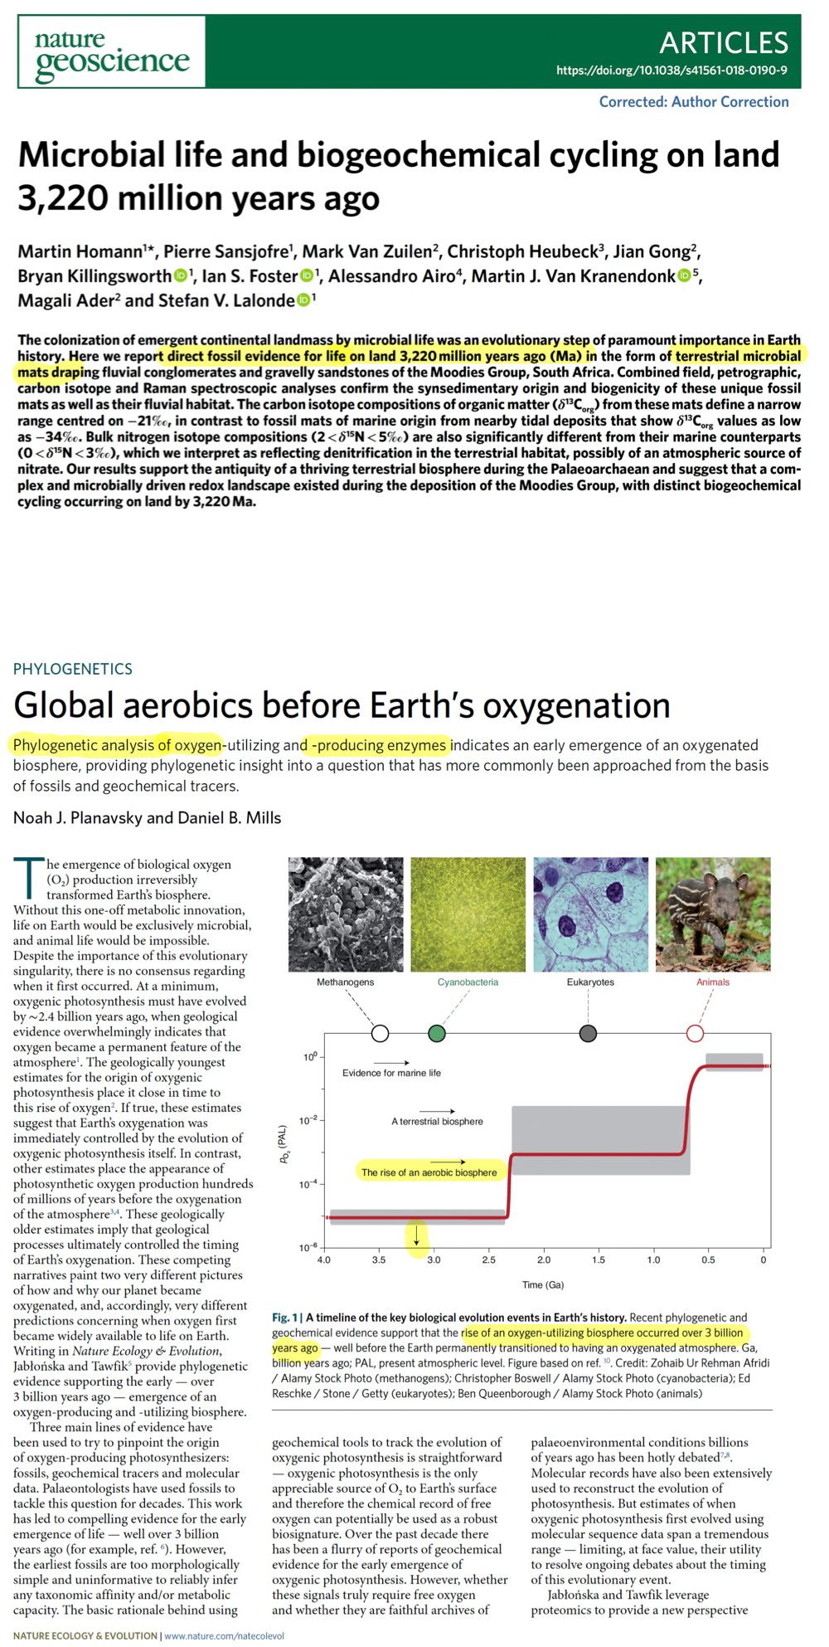

Slide 5
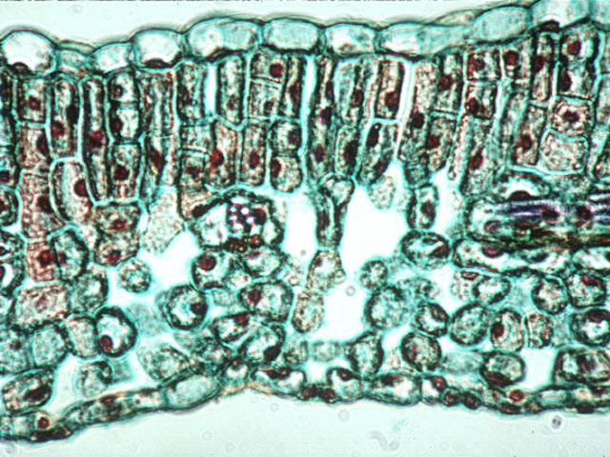
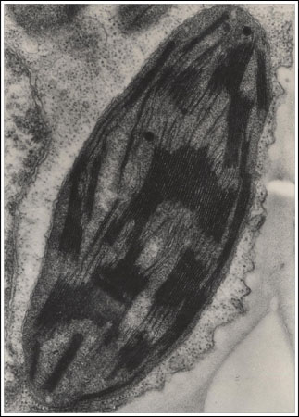
Notes:
http://virtual.yosemite.cc.ca.us/randerson/Lynn's%20Bioslides/slides.htm
http://www.nrc-cnrc.gc.ca/fra/education/index.html

Slide 6
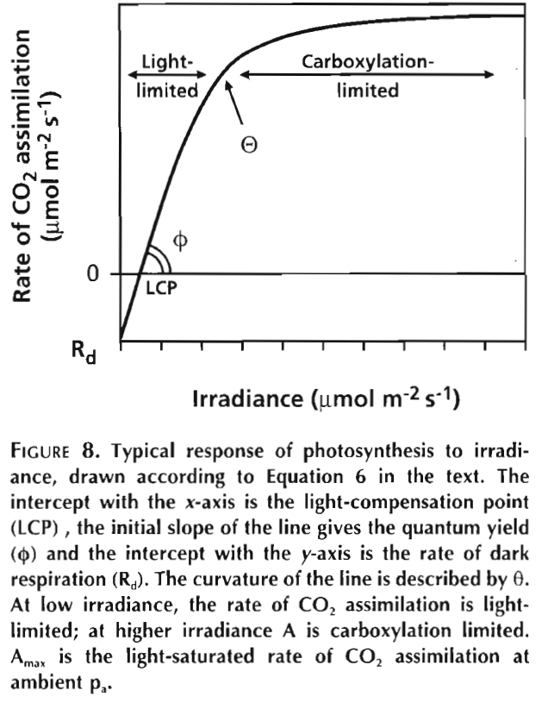
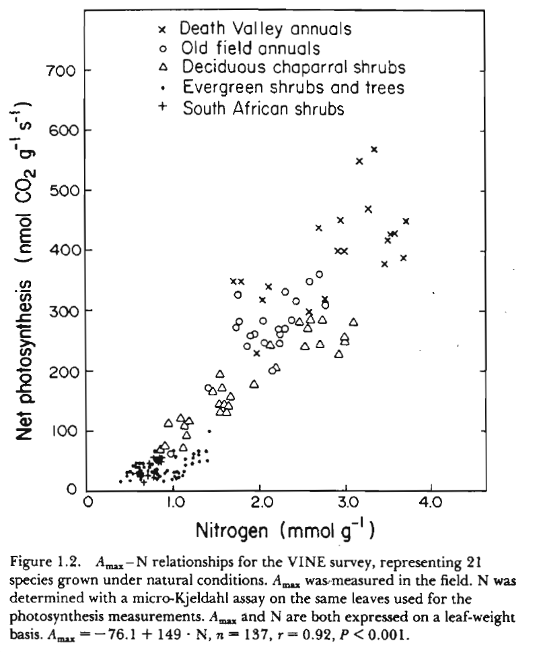
A_{ci} Curve
Ollinger et al.. 2002
CO₂ compensation point
Lambers et al. 1998
Aber et al. 1996

Slide 7
Chapin et al. 1987
O₂
CO₂
CO₂

Slide 8
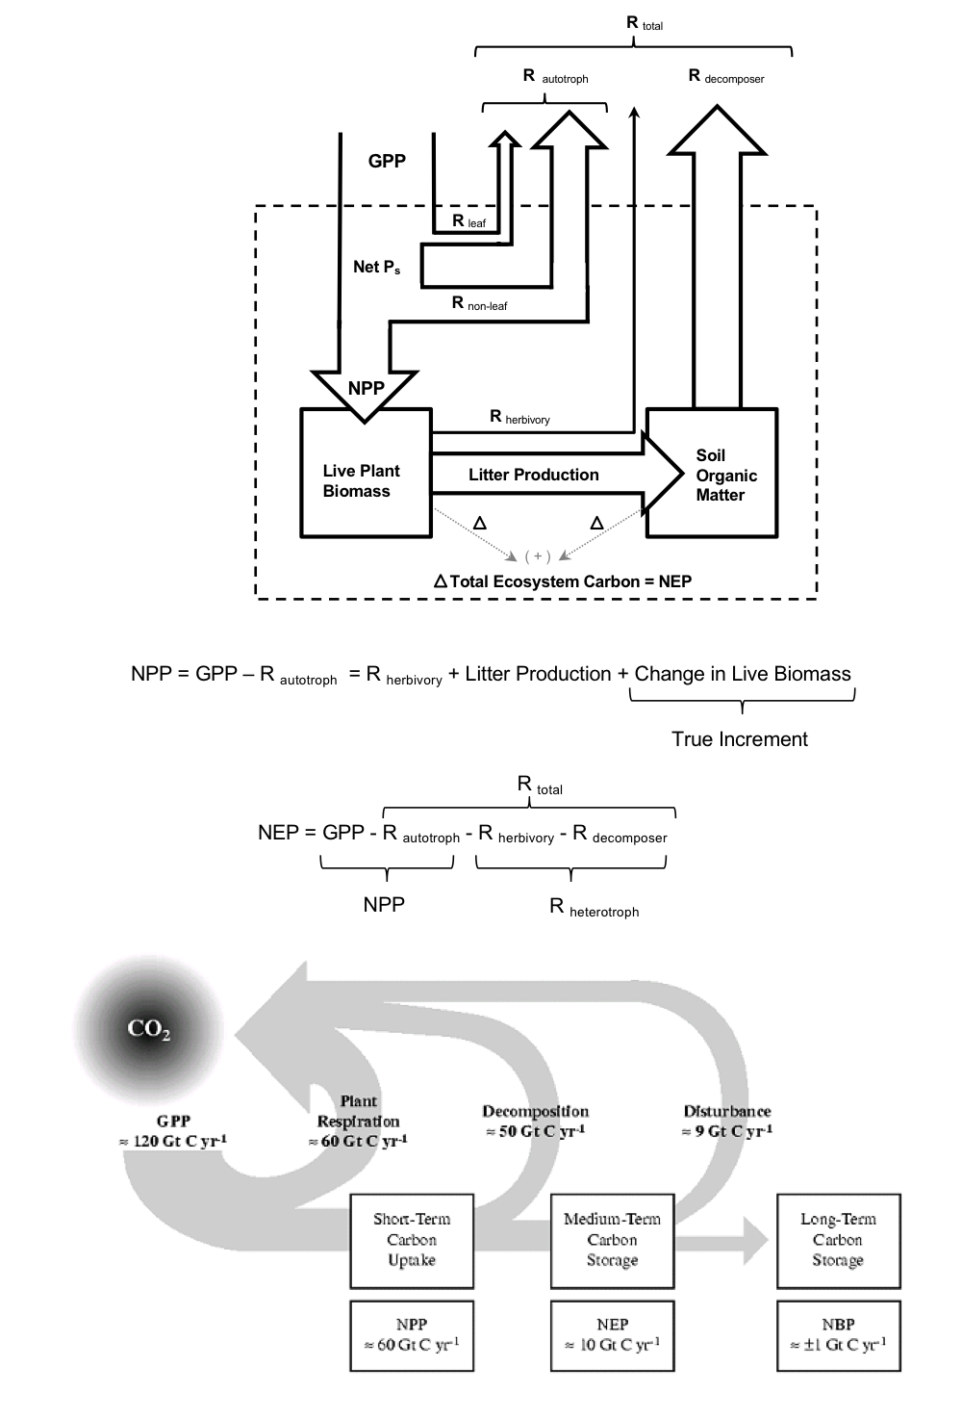

Slide 9
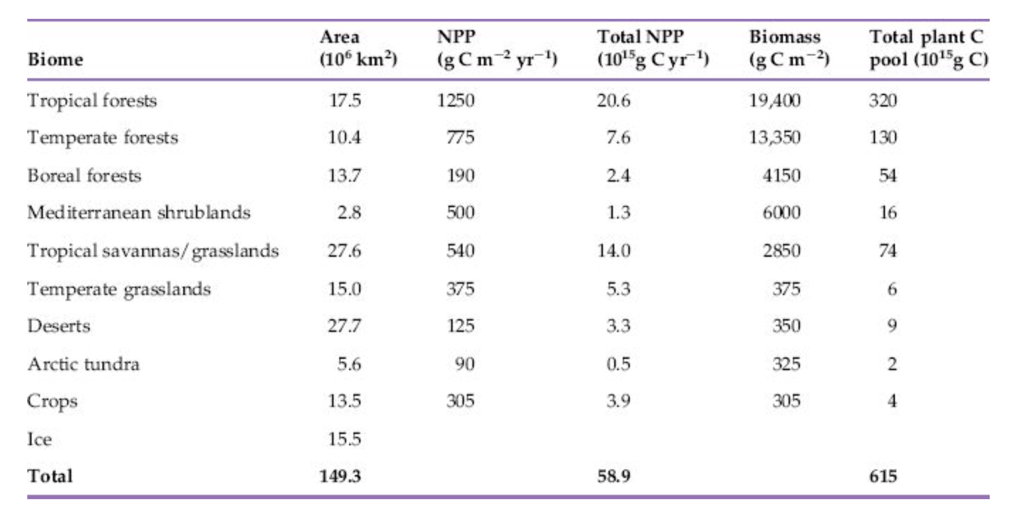
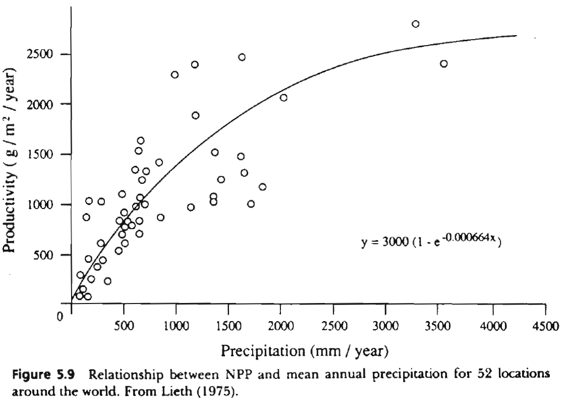

Slide 10
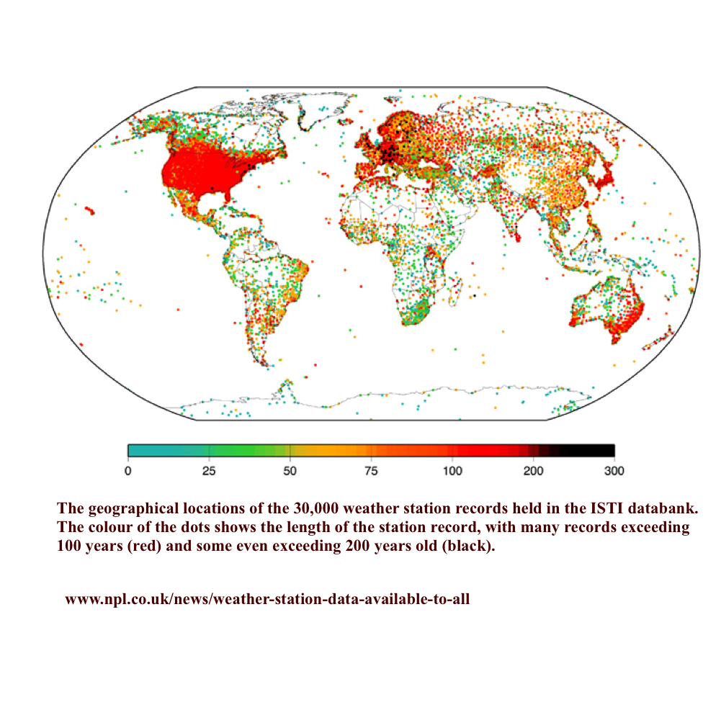

Slide 11
63 Pg C/yr
Melillo et al. 1993

Slide 12
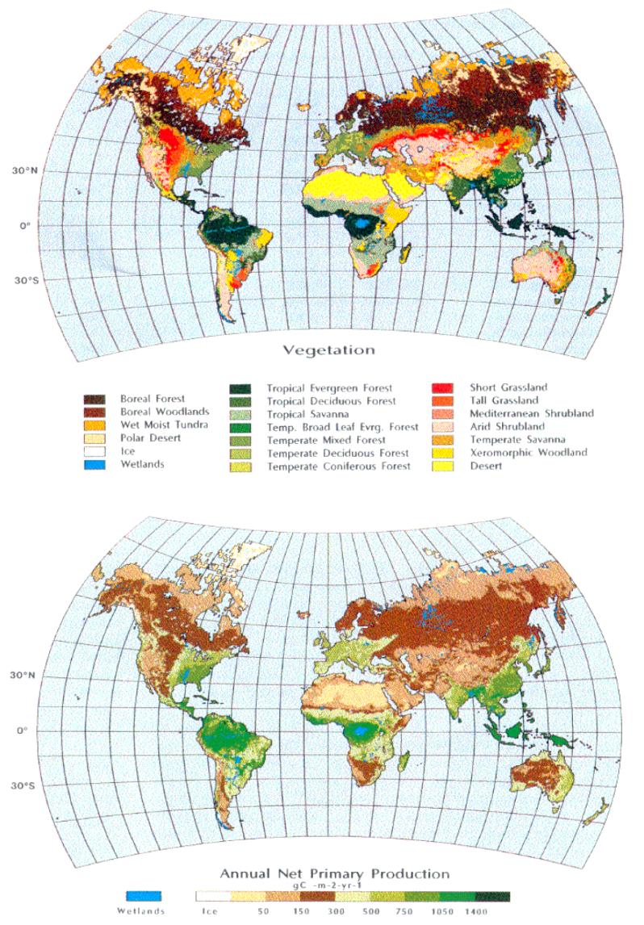
53.3 Pg C/yr
Melillo et al. 1993

Slide 13
Satellite-Based Methods
Passive Sensors Using Reflected Light

Slide 14
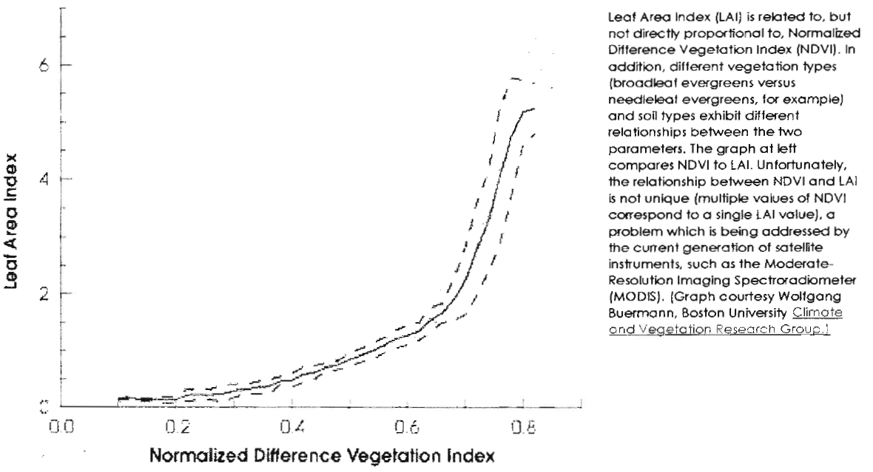
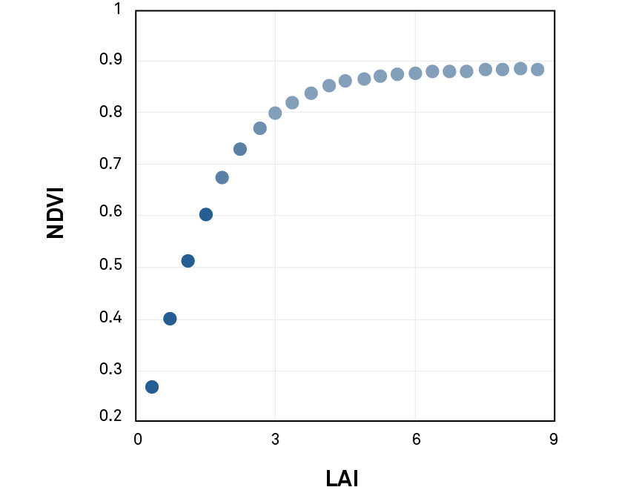
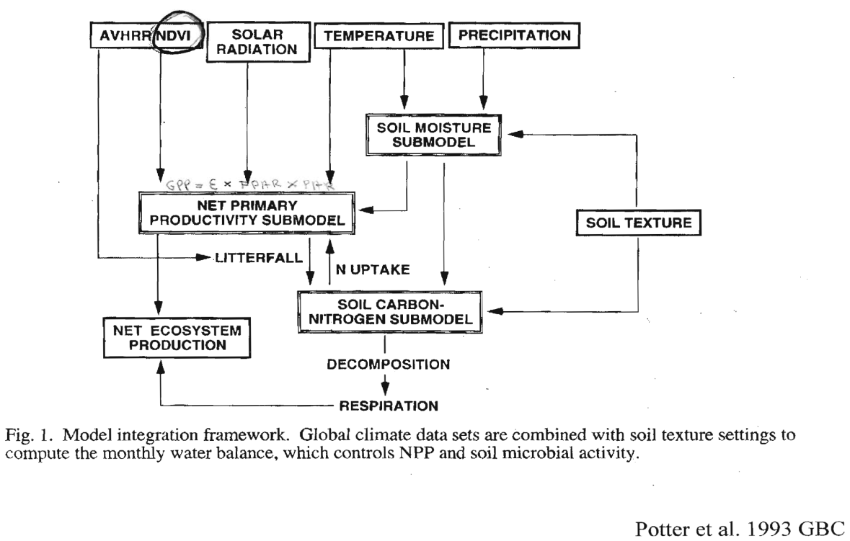
NPP = FPAR * PAR * E

Slide 15
https://www.youtube.com/watch?v=OK_HI3sjbtI
48 Pg C/yr
Potter et al. 1993

Slide 16
Satellite-Based Methods
Passive Sensors Using Emitted Light

Slide 17
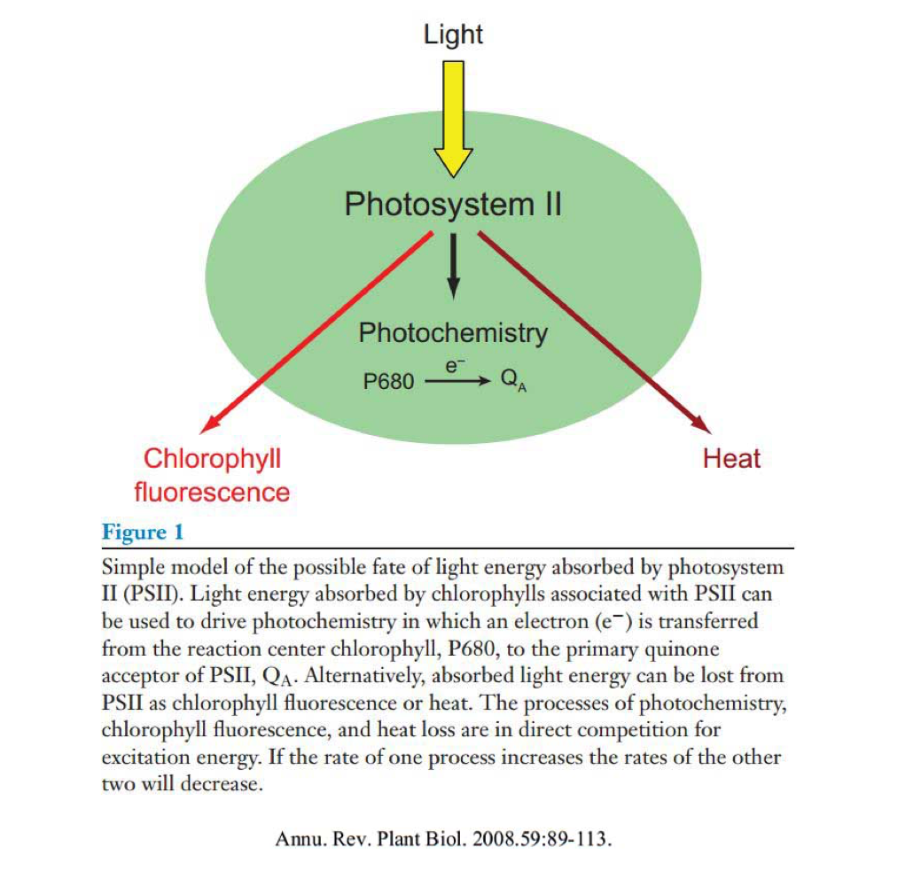
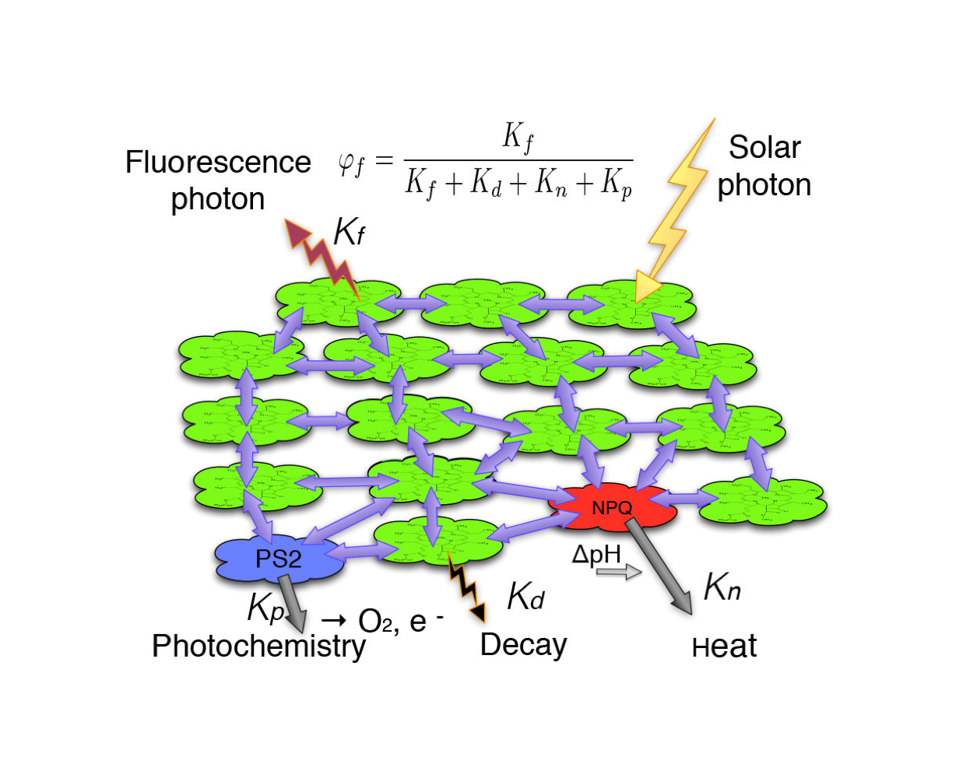
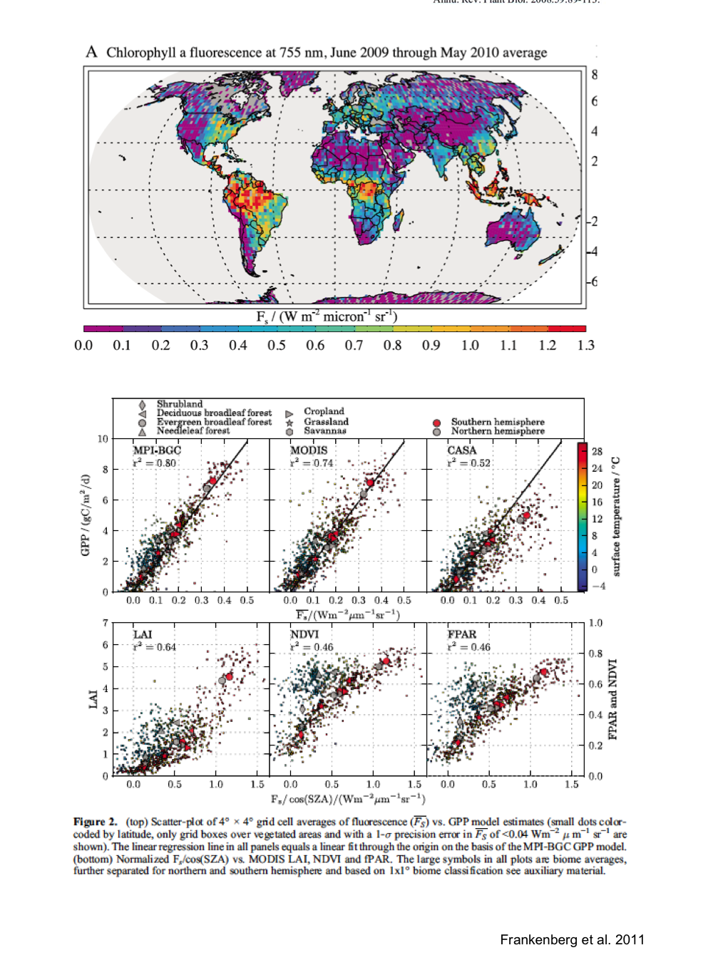

Slide 18
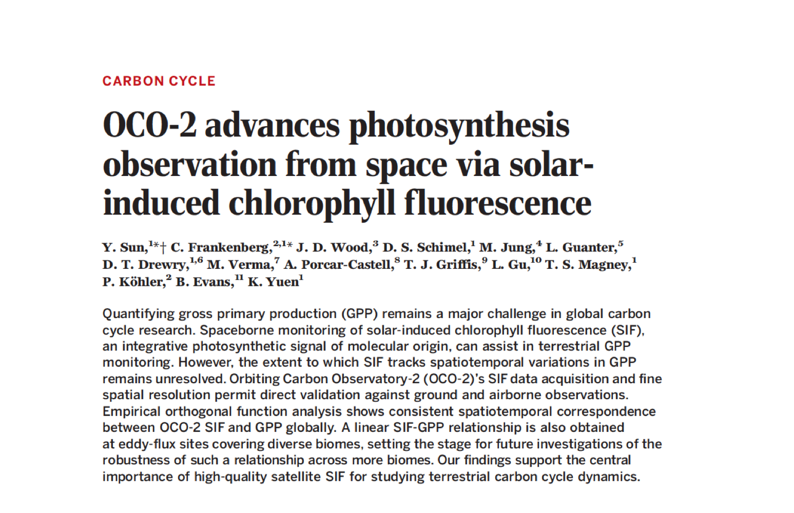
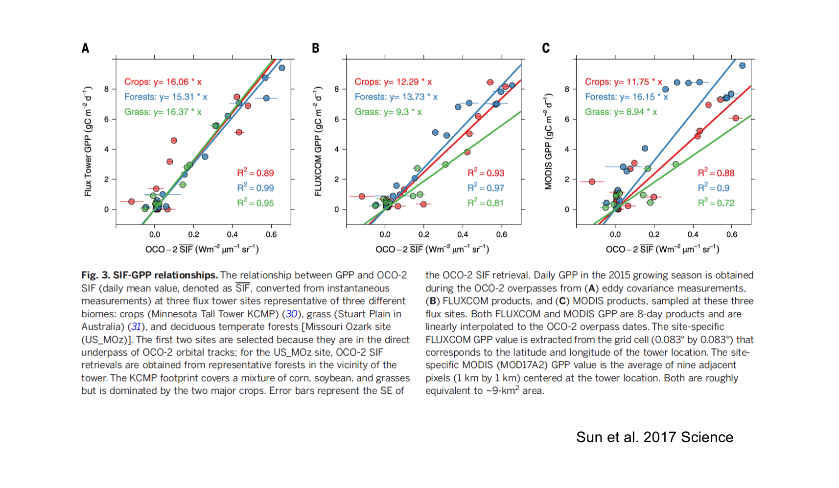

Slide 19
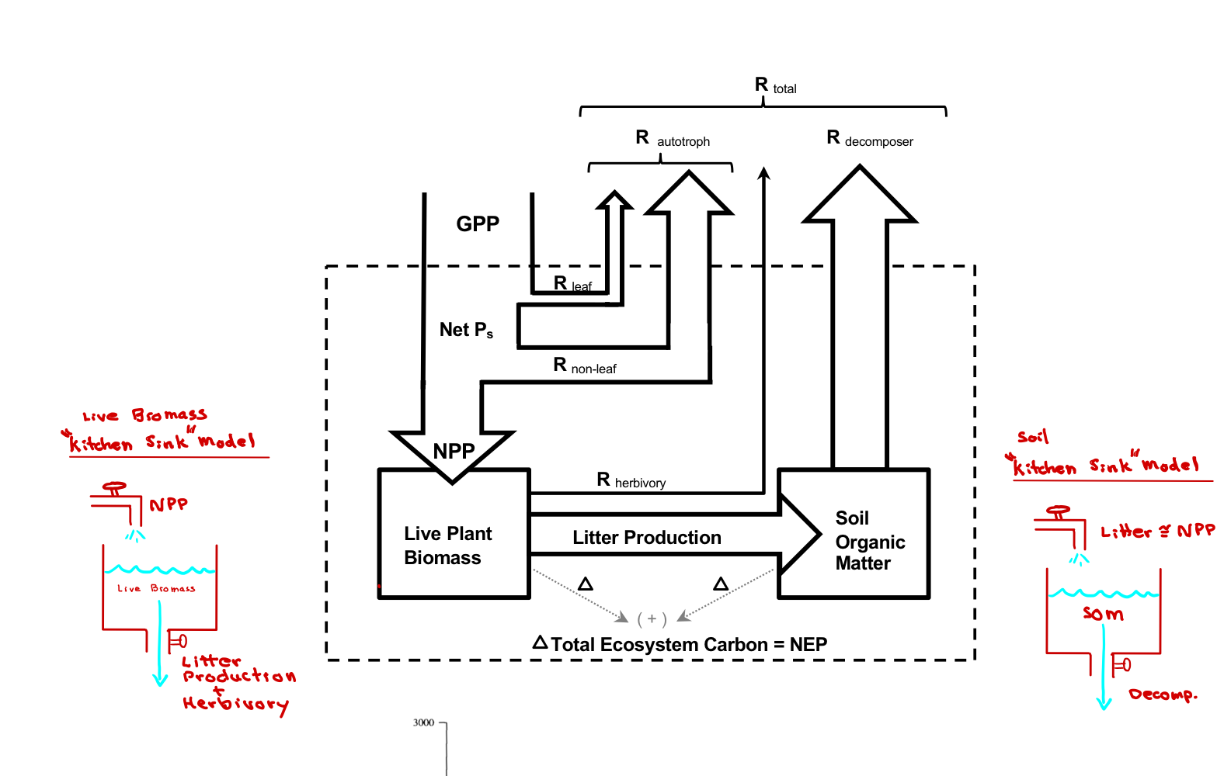

Slide 20
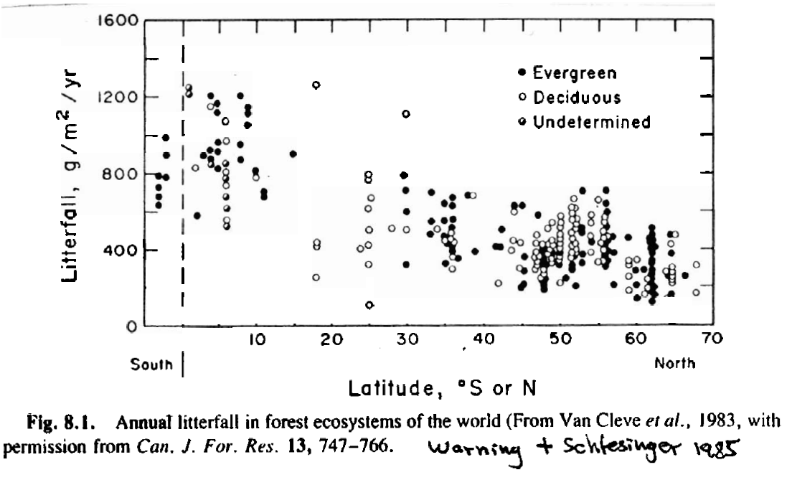
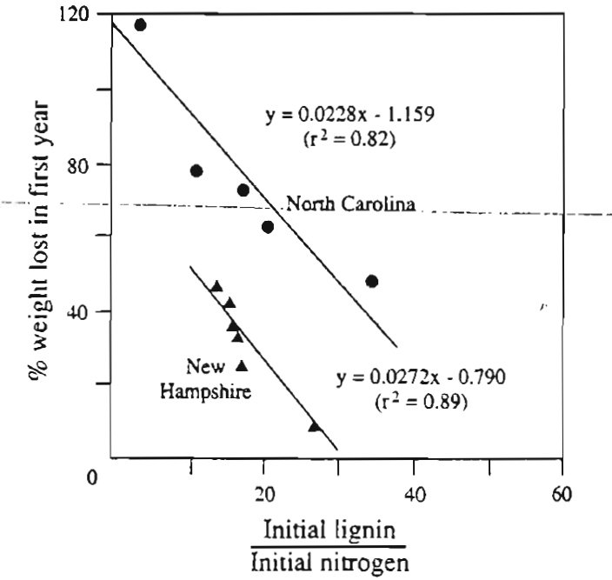
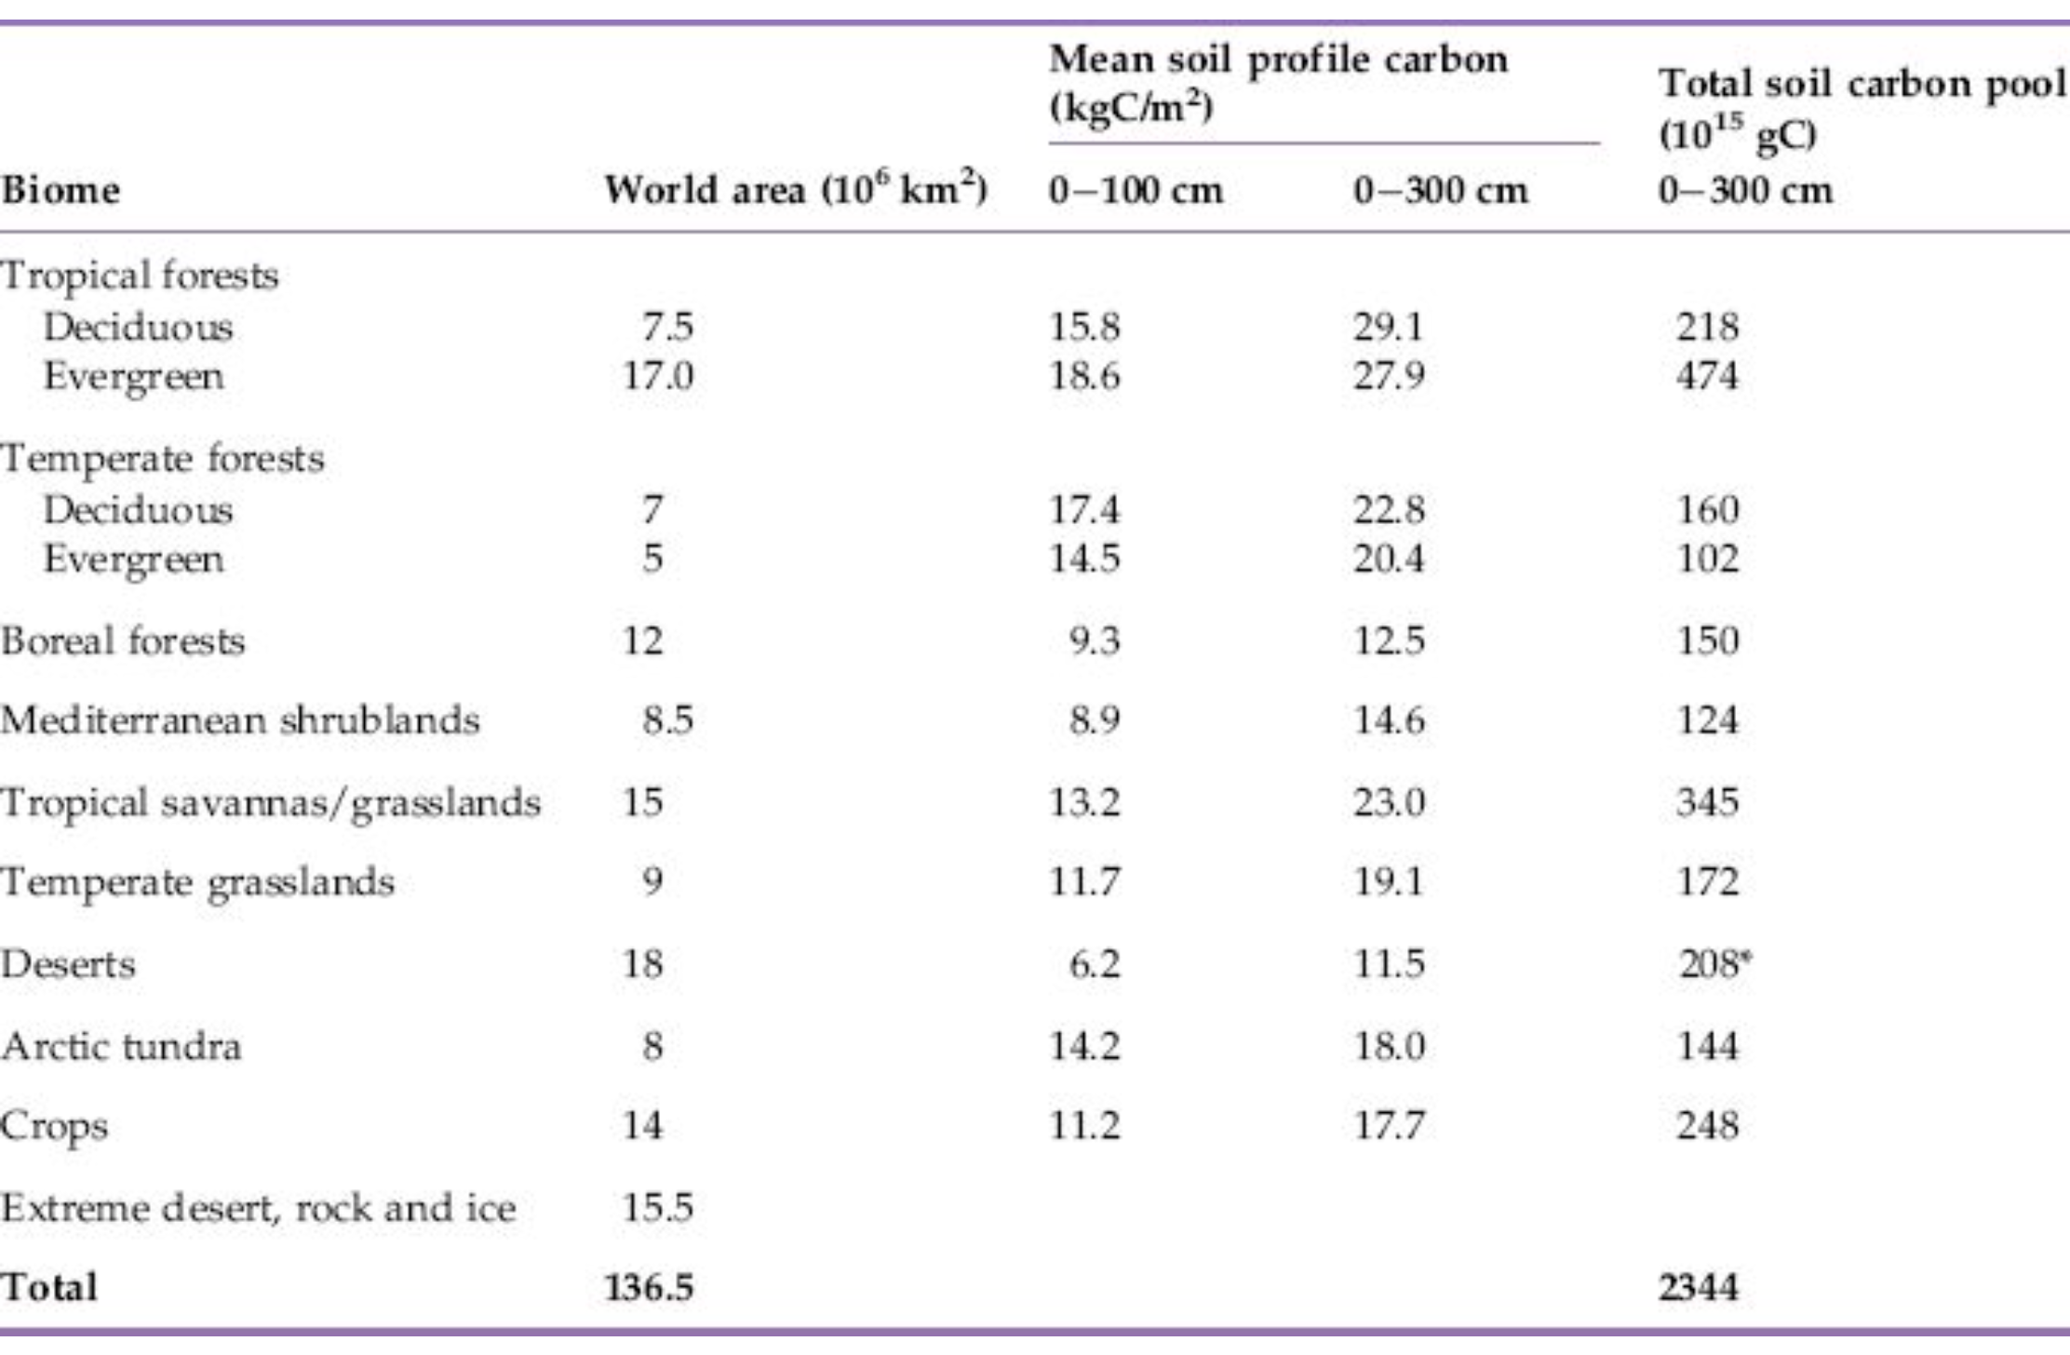

Slide 21
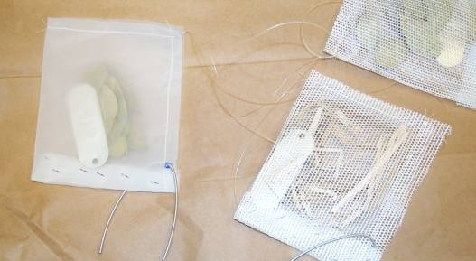
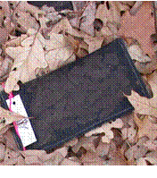
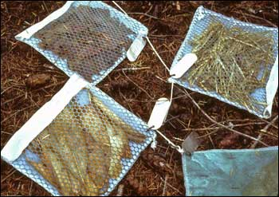

Slide 22
